Slide 1
CSE 403 Lecture 24
Scrum and Agile Software Development
Reading:
Scrum Primer, by Deemer/Benefield/Larman/Vodde
slides created by Marty Stepp
http://www.cs.washington.edu/403/

Slide 2
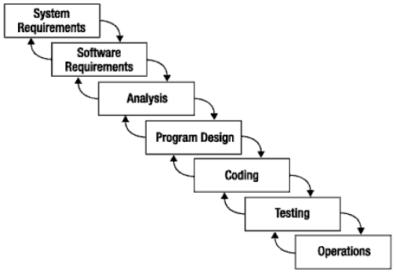
What is Scrum?
Scrum:
Is an agile, lightweight process
Can manage and control software and product development
Uses iterative, incremental practices
Has a simple implementation
Increases productivity
Reduces time to benefits
Embraces adaptive, empirical systems development
Is not restricted to software development projects
Embraces the opposite of the waterfall approach…
It’s about common sense

Slide 3



Scrum Origins
Jeff Sutherland
Initial scrums at Easel Corp in 1993
IDX and 500+ people doing Scrum
Ken Schwaber
ADM
Scrum presented at OOPSLA 96 with Sutherland
Author of three books on Scrum
Mike Beedle
Scrum patterns in PLOPD4
Ken Schwaber and Mike Cohn
Co-founded Scrum Alliance in 2002, initially within Agile Alliance

Slide 4


Agile Manifesto
Individuals and interactions
Process and tools
over
Working software
Comprehensive documentation
over
Customer collaboration
Contract negotiation
over
Responding to change
Following a plan
over
Source: www.agilemanifesto.org

Slide 5

Project Noise Level
Far from
Agreement
Anarchy
Complex
Requirements
Complicated
Source: Strategic Management and Organizational Dynamics by Ralph Stacey in Agile Software Development with Scrum by Ken Schwaber and Mike Beedle.
Close to
Agreement
Simple
Technology
Close to
Certainty
Far from
Certainty

Slide 6
Scrum at a Glance
24 hours
Daily Scrum
Meeting
Backlog tasks
expanded
by team
30 days
Sprint Backlog
Potentially Shippable
Product Increment
Product Backlog
As prioritized by Product Owner
Source: Adapted from Agile Software Development with Scrum by Ken Schwaber and Mike Beedle.

Slide 7

Sequential vs. Overlap
Requirements
Design
Code
Test
Rather than doing all of one thing at a time...
...Scrum teams do a little of everything all the time

Slide 8
Scrum Framework
Roles
Product owner
Scrum Master
Team
Ceremonies
Sprint planning
Sprint review
Sprint retrospective
Daily scrum meeting
Artifacts
Product backlog
Sprint backlog
Burndown charts

Slide 9







Scrum Roles
Product Owner
Possibly a Product Manager or Project Sponsor
Decides features, release date, prioritization, $$$
Scrum Master
Typically a Project Manager or Team Leader
Responsible for enacting Scrum values and practices
Remove impediments / politics, keeps everyone productive
Project Team
5-10 members; Teams are self-organizing
Cross-functional: QA, Programmers, UI Designers, etc.
Membership should change only between sprints

Slide 10


"Pigs" and "Chickens"
Pig: Team member committed to success of project
Chicken: Not a pig; interested but not committed
A pig and a chicken are walking down a road. The chicken looks at the pig and says, "Hey, why don't we open a restaurant?" The pig looks back at the chicken and says, "Good idea, what do you want to call it?" The chicken thinks about it and says, "Why don't we call it 'Ham and Eggs'?" "I don't think so," says the pig, "I'd be committed but you'd only be involved."

Slide 11


Sprint Planning Mtg.
Team capacity
Sprint planning meeting
Sprint prioritization
Sprint
goal
Product backlog
Analyze/evaluate product backlog
Select sprint goal
Business conditions
Sprint planning
Decide how to achieve sprint goal (design)
Create sprint backlog (tasks) from product backlog items (user stories / features)
Estimate sprint backlog in hours
Current product
Sprint
backlog
Technology

Slide 12
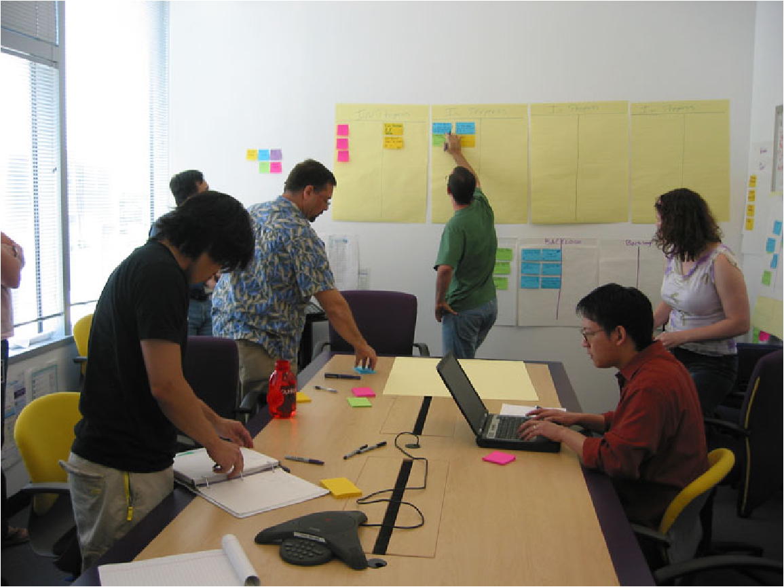
Daily Scrum Meeting
Parameters
Daily, ~15 minutes, Stand-up
Anyone late pays a $1 fee
Not for problem solving
Whole world is invited
Only team members, Scrum Master, product owner, can talk
Helps avoid other unnecessary meetings
Three questions answered by each team member:
What did you do yesterday?
What will you do today?
What obstacles are in your way?
Notes:
‹#›

Slide 13
Scrum's Artifacts
Scrum has remarkably few artifacts
Product Backlog
Sprint Backlog
Burndown Charts
Can be managed using just an Excel spreadsheet
More advanced / complicated tools exist:
Expensive
Web-based – no good for Scrum Master/project manager who travels
Still under development

Slide 14

Product Backlog
The requirements
A list of all desired work on project
Ideally expressed as a list of user stories along with "story points", such that each item has value to users or customers of the product
Prioritized by the product owner
Reprioritized at start of each sprint
This is the product backlog

Slide 15
User Stories
Instead of Use Cases, Agile project owners do "user stories"
Who (user role) – Is this a customer, employee, admin, etc.?
What (goal) – What functionality must be achieved/developed?
Why (reason) – Why does user want to accomplish this goal?
As a [user role], I want to [goal], so I can [reason].
Example:
"As a user, I want to log in, so I can access subscriber content."
story points: Rating of effort needed to implement this story
common scales: 1-10, shirt sizes (XS, S, M, L, XL), etc.

Slide 16
Sample Product Backlog
Backlog item | Estimate
Allow a guest to make a reservation | 3 (story points)
As a guest, I want to cancel a reservation. | 5
As a guest, I want to change the dates of a reservation. | 3
As a hotel employee, I can run RevPAR reports (revenue-per-available-room) | 8
Improve exception handling | 8
... | 30
... | 50
Notes:
‹#›

Slide 17
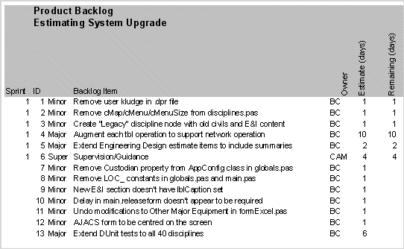
Sample Product Backlog 2

Slide 18
Sprint Backlog
Individuals sign up for work of their own choosing
Work is never assigned
Estimated work remaining is updated daily
Any team member can add, delete change sprint backlog
Work for the sprint emerges
If work is unclear, define a sprint backlog item with a larger amount of time and break it down later
Update work remaining as more becomes known

Slide 19
Sample Sprint backlog
Tasks
Mon
Tue
Wed
Thu
Fri
Code the user interface
8
4
8
Code the middle tier
16
12
10
4
Test the middle tier
8
16
16
11
8
Write online help
12
Write the Foo class
8
8
8
8
8
Add error logging
8
4
Notes:
‹#›

Slide 20
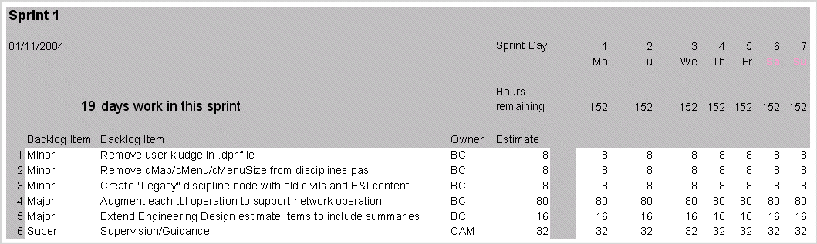
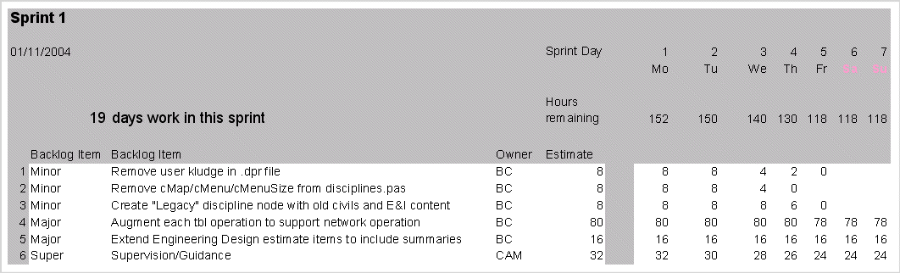
Sample Sprint Backlog

Slide 21
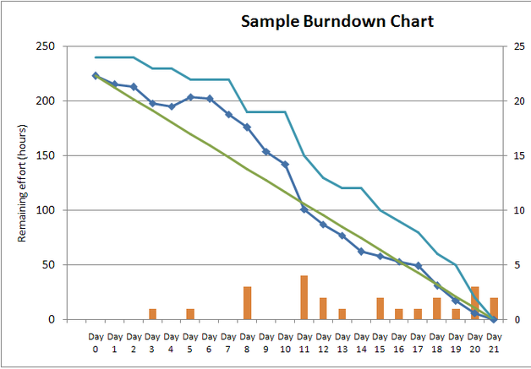
Sprint Burndown Chart
A display of what work has been completed and what is left to complete
one for each developer or work item
updated every day
(make best guess about hours/points completed each day)
variation: Release burndown chart
shows overall progress
updated at end of each sprint

Slide 22
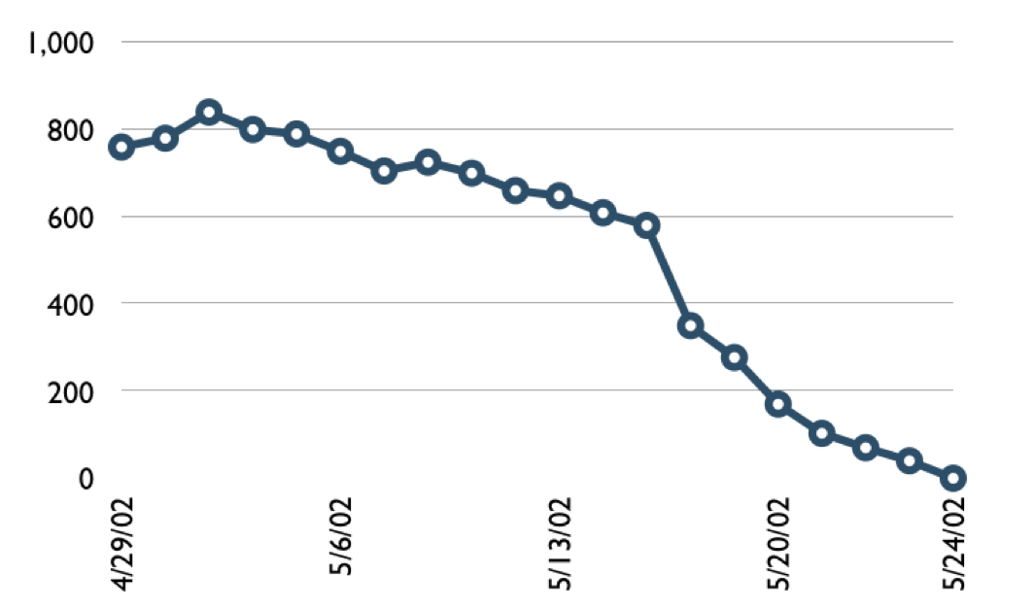
Sample Burndown Chart
Hours
Notes:
‹#›

Slide 23
Tasks
Mon
Tue
Wed
Thu
Fri
Code the user interface
8
4
8
Code the middle tier
16
12
10
7
Test the middle tier
8
16
16
11
8
Write online help
12
50
40
30
Hours
20
10
0
Mon
Tue
Wed
Thu
Fri
Notes:
‹#›

Slide 24
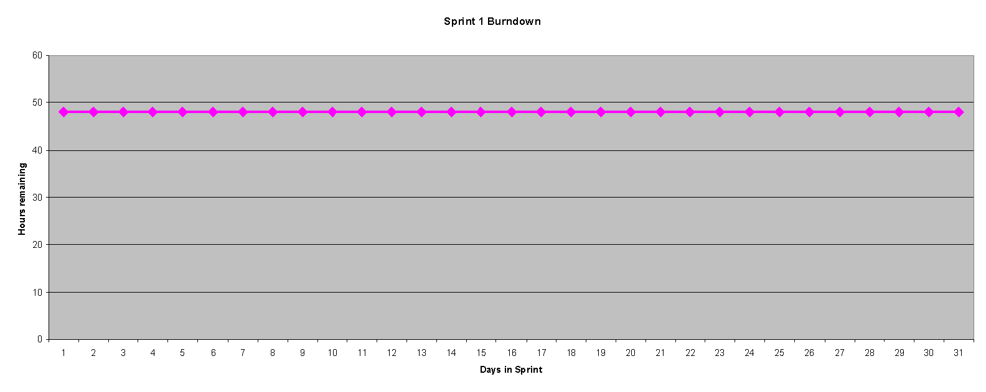
Burndown Example 1
No work being performed

Slide 25
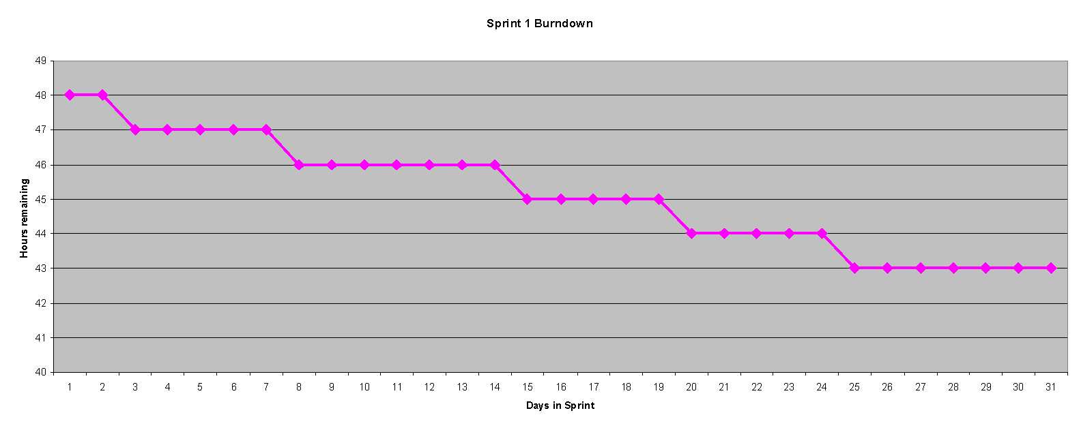
Burndown Example 2
Work being performed, but not fast enough

Slide 26
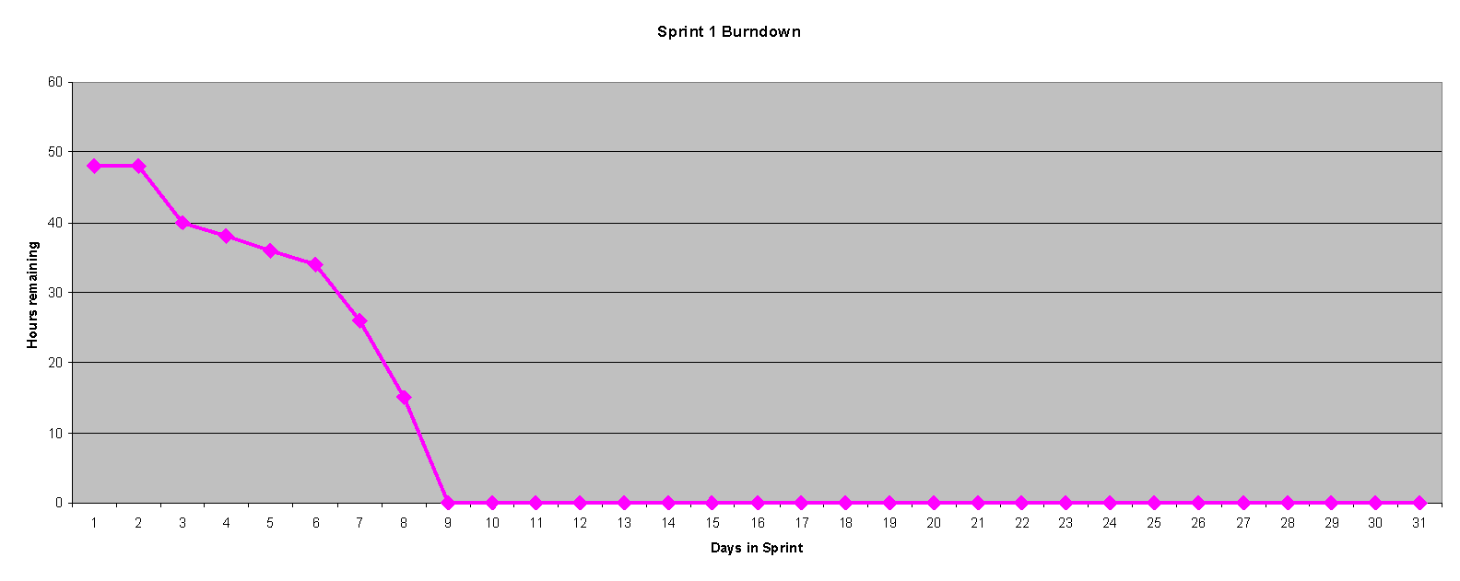
Burndown Example 3
Work being performed, but too fast!

Slide 27
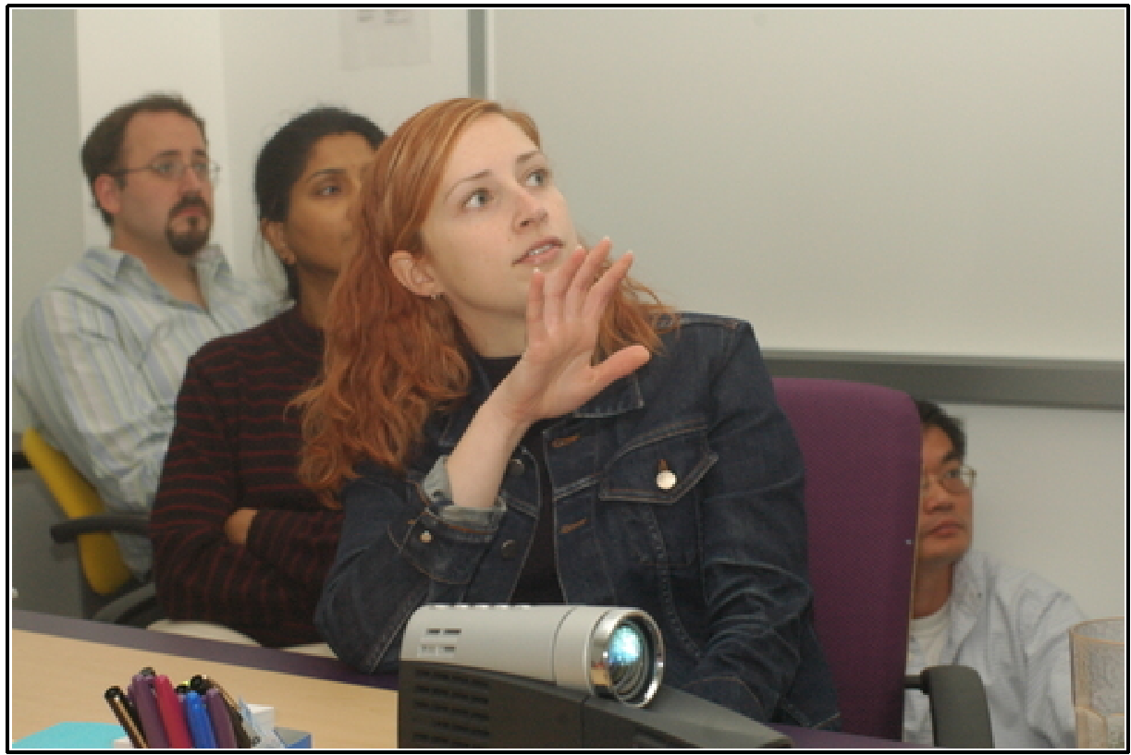
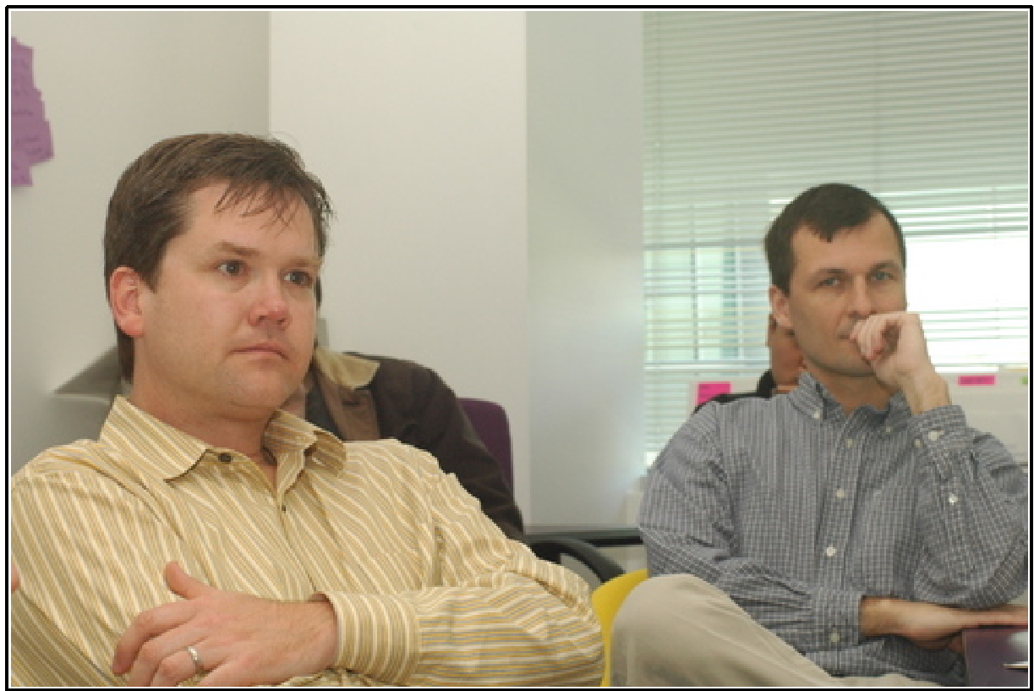
The Sprint Review
Team presents what it accomplished during the sprint
Typically takes the form of a demo of new features or underlying architecture
Informal
2-hour prep time rule
No slides
Whole team participates
Invite the world

Slide 28
Scalability
Typical individual team is 7 ± 2 people
Scalability comes from teams of teams
Factors in scaling
Type of application
Team size
Team dispersion
Project duration
Scrum has been used on multiple 500+ person projects

Slide 29






Scaling: Scrum of Scrums

Slide 30
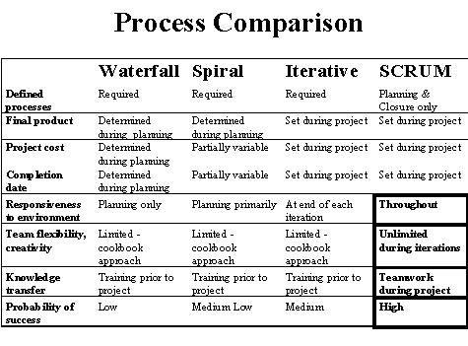
Scrum vs. Other Models

Slide 31

Credits, References
Mike Cohn, Mountain Goat Software www.mountaingoatsoftware.com
Scrum and The Enterprise by Ken Schwaber
Succeeding with Agile by Mike Cohn
Agile Software Development Ecosystems by Jim Highsmith
Agile Software Development with Scrum by K. Schwaber and M. Beedle
User Stories Applied for Agile Software Development by Mike Cohn
www.agilescrum.com/
www.objectmentor.com
jeffsutherland.com/
www.controlchaos.com/scrumwp.htm
agilealliance.com/articles/articles/InventingScrum.pdf

